Slide 1


Capstone Project Predicting the Attendance 2023 for 4 Cost Centers
Team Members Esha Esha Lauren Lussier Ravneet Kaur Malhi Sumita Dhull Wali Hyder
April 13 , 2023
Business Intelligence System Infrastructure Program
Notes:
r

Slide 2






Index
2
1.Executive Summary
2. Data Preparation & Exploratory Data Analysis
2
3. Feature Engineering
4. Model Selection & ….Training
5. Data Validation &
Visualizations
6. Recommendation
Notes:
r

Slide 3
Executive Summary
We are pleased to be presenting the capstone project sponsored by Canada Post for the fulfillment of the degree for our course at Algonquin College of Applied Arts and Technology.
Our sincere thanks to Mr. Swapnil Kangralkar, Ms. Rani Adhaduk and Professor Jim Myronyk for their relentless support, and kind guidance in making this project a success.
We developed a predictive model to accurately forecast attendance of workers in the distribution plants/depots for the year 2023, based on historical attendance data (2019 and 2022)
Key Factors taken into consideration:
Past Attendance Patterns
Four Cost Centres- Mississauga, Brossard, Victoria, RedDeer
Weather data
Holidays in Canada Post (National and Provincial)
Notes:
r

Slide 4




Our Approach
Planning
The most crucial aspect deciding our way of working. From the tools to be used to weekly client updates, every aspect of the project was planned and drafted into a Timeline with ownership assigned to team members.
Data Visualization & Analytics
Algorithm Selection & Model Training
Phase wise approach was adopted for Data Cleaning, EDA, and Feature Engineering. We explored different models through training and evaluation to find an optimal one.
Technical Deep Dive
Project Planning
Bringing it all Together
With the optimal model , Predications were done, Visualizations were created to give insights and provide validation to our predicted values
Notes:
r

Slide 5
Tools & Methods Used
Programming Language - Python V.3.10.8
Programming Package – Anaconda Navigator V.2.3.2
Python IDE- Jupyter Notebook V.6.4.11
BI Tool – Power BI 2022
Weather Data API - Free Open-Source Weather API | Open-Meteo.com
Project Timeline – Project Management Template
Notes:
w

Slide 6
Data Preparation
Canada Post initial datasets were ;
Attendance Dataset - 2019 & 2022
Holiday Dataset - 2019 & 2022
Data Cleaning was performed using python programming and excel formulas
Tasks included merging, renaming column names, dropping columns, replacing null values and sorting
Holiday list and Updated Attendance List were merged as a single sheet
“StatDay” & “WorkDay” features status were updated in the main sheet
Notes:
w

Slide 7
Feature Engineering
Creation of a new feature to include the weather information according to the postal code location
Weather Data extraction as .xlsx and API URL from Open-Mateo for 2019 & 2022.
Daily Weather Features added - Mean_Temp (°C), Precipitation_sum(mm), rain_sum(mm) snowfall_sum(cm) & total precipitation_hours(h)
Utilizing Excel formulas to clean and combine weather data producing a single sheet for all cost centers merged according to the desired period.
Creation of a final dataset by merging the attendance and weather data on the features (“ATTDATE” & “City”) ready to be fed into the Machine Learning model.
Notes:
w

Slide 8
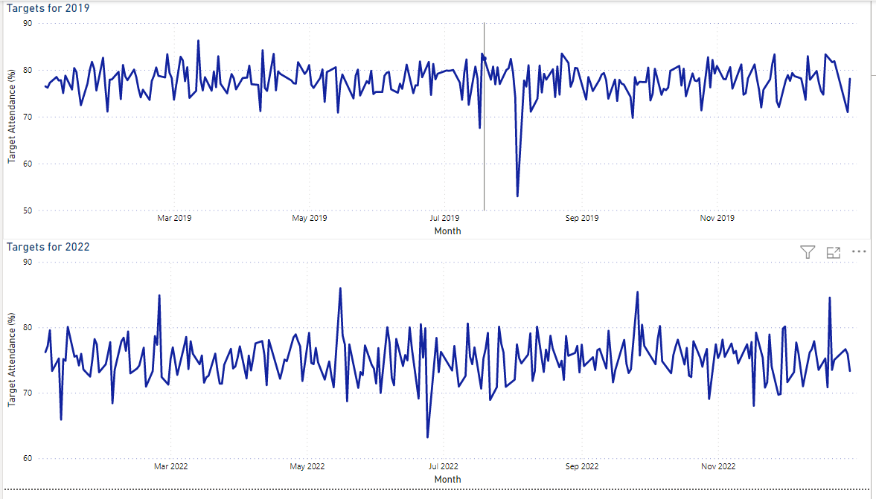
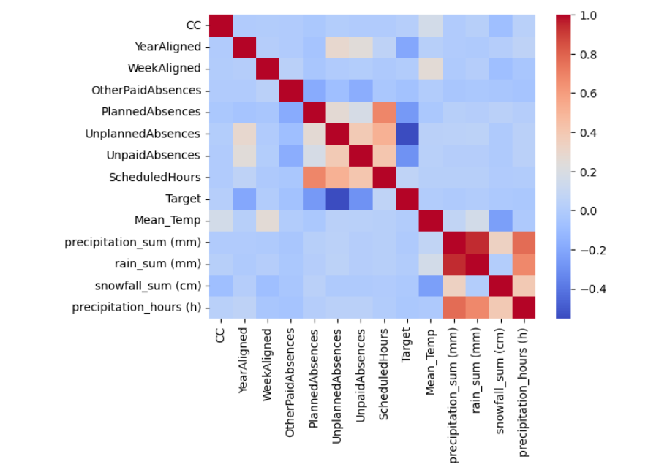
Exploratory Data Analysis (EDA)
Before feeding the data into the model, we plotted correlation matrix & pair plot to understand the relationship of the features with the target (i.e, attendance).
Notes:
l

Slide 9
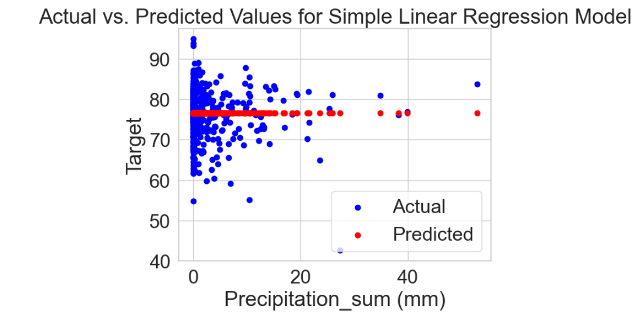
Model 1 - Simple Linear Regression
Linear Regression model was trained and tested for 2019 & 2022 at 75 - 25 split
Resulting in an average absolute difference between the actual and predicted values of the target variable at around 4.83% & 4.69% for test and train, respectively
By increasing the degree of the polynomial equation to 2 the error increased, suggesting an unfit model for the data
Plotting the “Percipation_sum” against the target variable.
Notes:
s

Slide 10
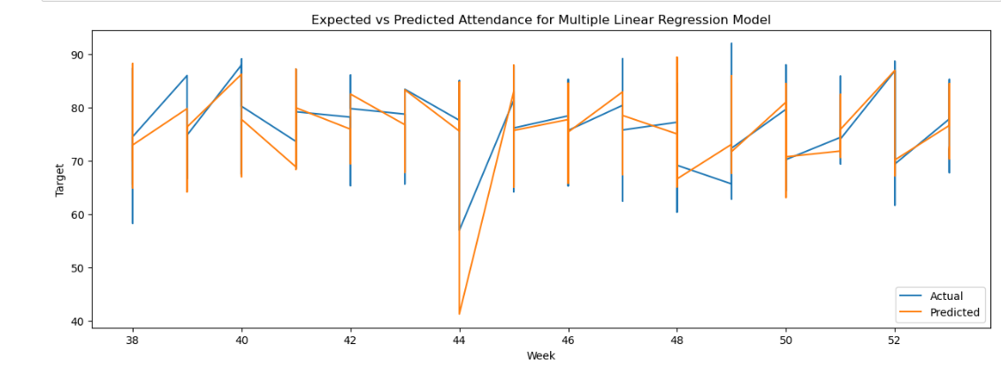
Model 2 - Multiple Linear Regression
By increasing the input features to train the model , the model performed better in test.
The error almost halved to around 2.4% (mean absolute error) , still not acceptable and sufficient enough for accurate predictions.
Notes:
s

Slide 11
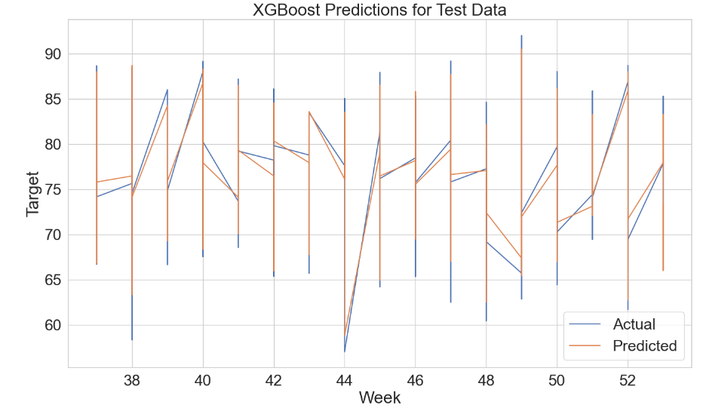
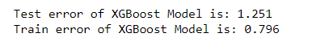
Model 3 - Extreme Gradient Boosting (XGBoost)
Notes:
s

Slide 12
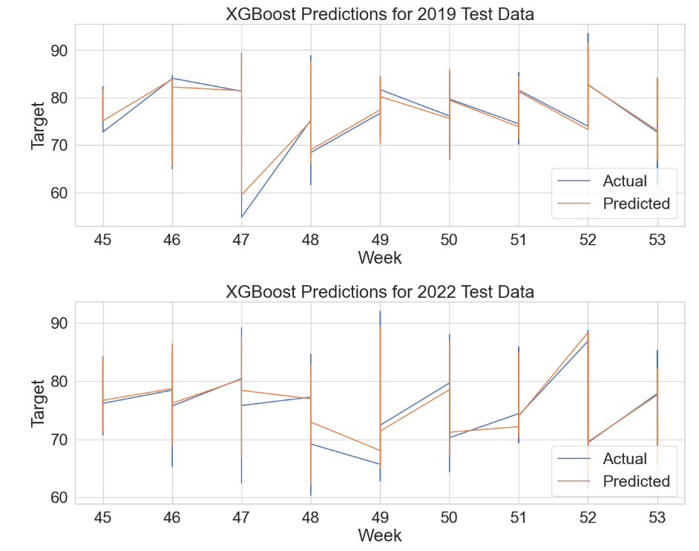
Model 3 – Test Data Plots
Notes:
s

Slide 13
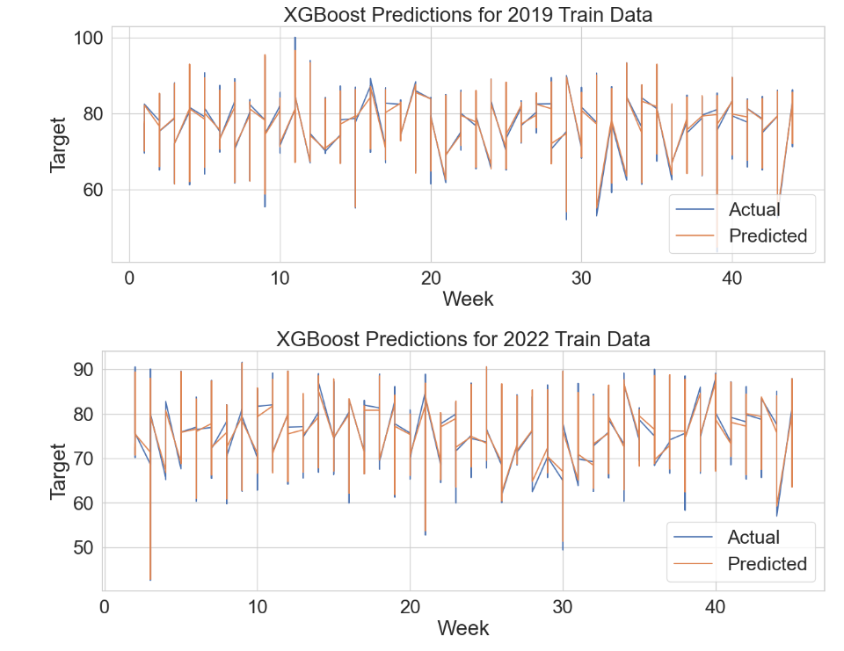
Model 3 – Train Data Plots
Notes:
s

Slide 14
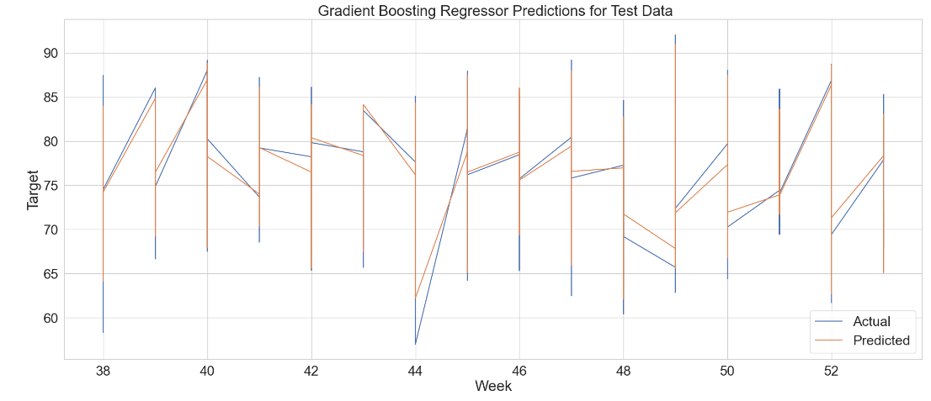
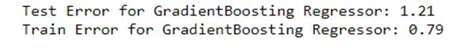
Model 4 - Gradient Boosting
Although XGBoost is a more advanced and faster version of Gradient Boosting, we stepped down to perform regular boosting.
Test accuracy slightly improved.
Notes:
e

Slide 15
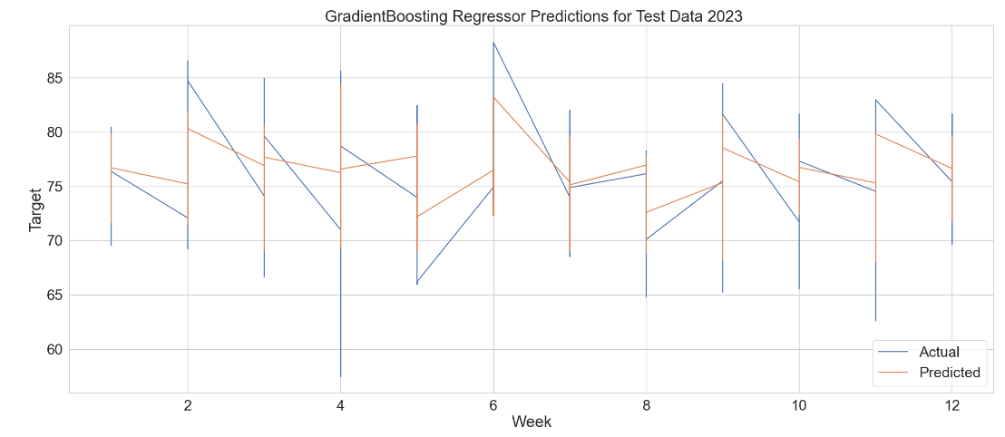
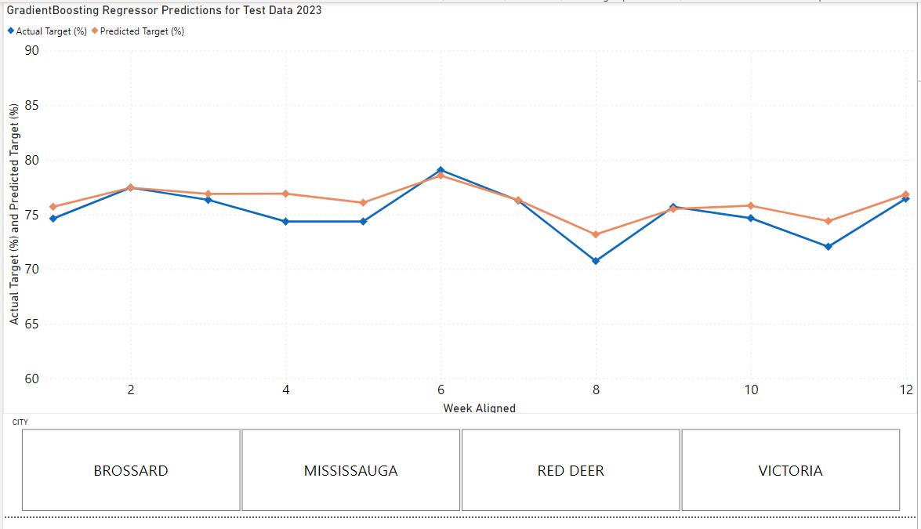
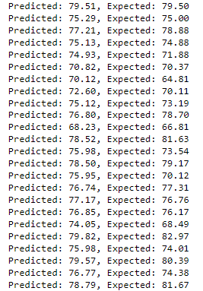
Data Validation
With the optimal model, the predicted values were plotted against the actual values
Visually apparent overlapping and obtained values confirm accuracy of the model
Attendance 2023 Dataset
Notes:
e

Slide 16
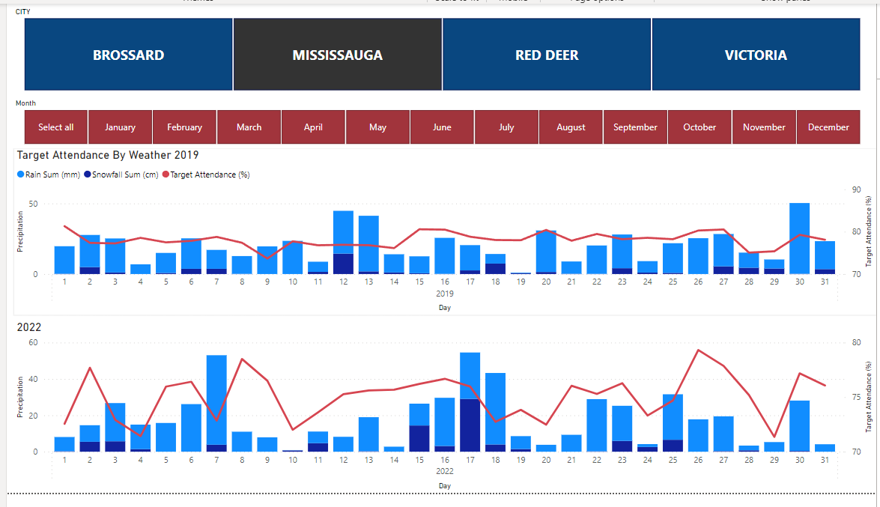
BI Visualizations
Notes:
l

Slide 17
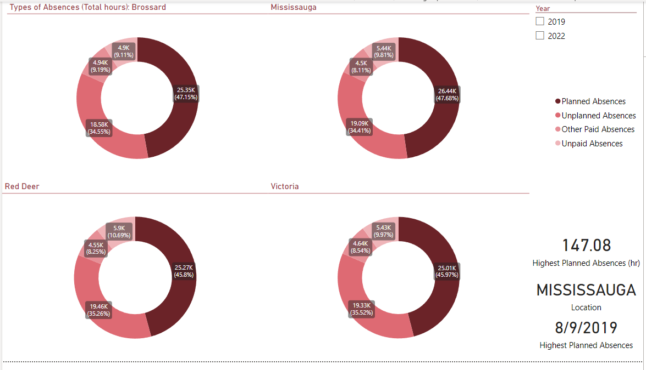
BI Visualizations
Notes:
l

Slide 18
Recommendations and Conclusions
Through the implementation of this project, we aspire to make a valuable contribution to Canada Post's ongoing efforts towards enhancing their operational efficiency.
While Efficiently managing the cost, the performance of the workforce can also be enhanced.
Utilizing Data Analytics and Machine Learning can assist in both forecasting attendance and making informed decisions based on data to achieve the desired attendance levels at the appropriate times.
According to trends in our predictive models, it was found that near the year’s end witnessed lower attendance rates. During this time, it could be advantageous to plan more scheduled hours to meet peak season demands as seen typically around holidays and the end of the year
Notes:
e

Slide 19
Next Steps
To enhance model accuracy and operational efficiency:
Perform additional hyperparameter tuning/optimization for example, changing learning rates
Increased diversity of the dataset, including more cost centers, years, job types, employee surveys
Include more variables that are strongly correlated to the target.
Notes:
e

Slide 20
Merci |Thank you
Notes:
r

